Slide 1

Predicting MLB’s Top 10 MVP Nominee
December 10, 2021
Create by Sooji Rhodes

Slide 2

Introduction
At the end of each season, a randomly selected group of sports writers in the Baseball Writers Association of America (BBWAA) receive a blank ballot for the Most Valuable Player (MVP) nomination for each league (American and National). The ballots are then consolidated and aggregated (weighted by the rank), and the Major League Baseball (MLB) posts the top 20 players from each league.
This Photo by Unknown Author is licensed under CC BY-SA

Slide 3
Assumptions and considerations
Eligible players must have at least 502 plate appearance, in order to weed out any outliers.
The training data will be the statistics between 2013 and 2019, and the test data will be the statistics for 2021.
I am only considering top 10. Hence, considering both leagues, 20 out of all players will be considered nominated as the MVP.
Because I intend to look at only hitting records, pitchers will not be considered in my dataset. Only batters, including catchers, will be considered.
The data will come from Baseball Reference website for the MVP nomination and FanGraphs for the player statistics.

Slide 4
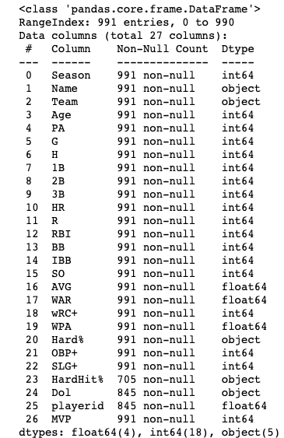
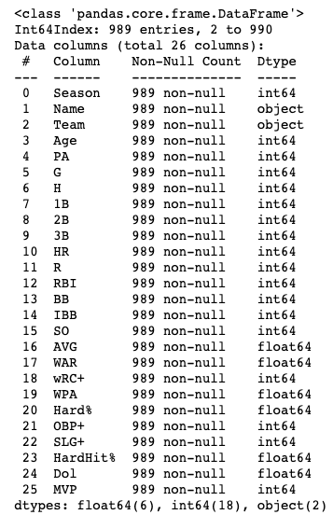
Exploratory Data Analysis – Data Cleaning

Slide 5
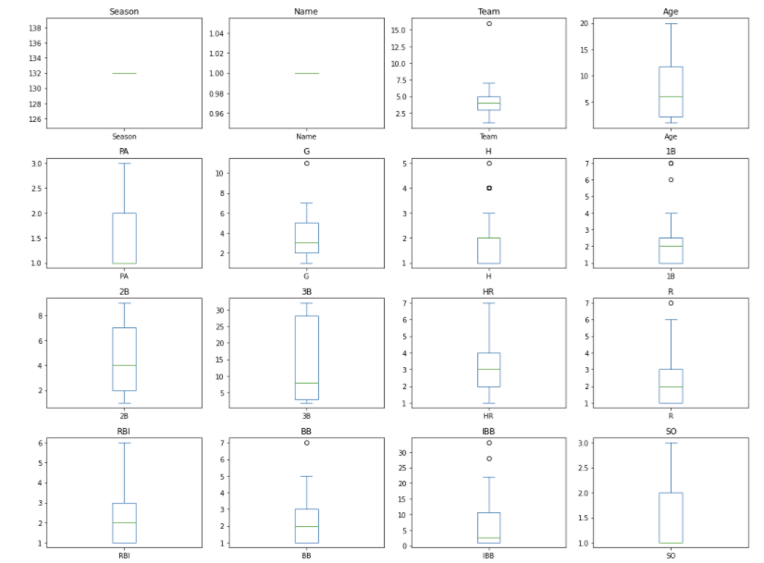
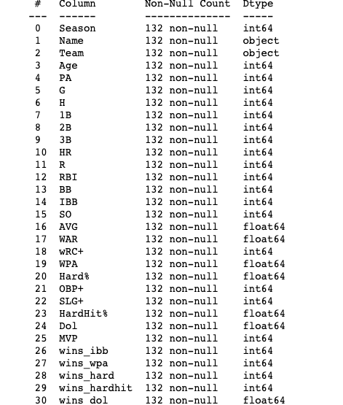
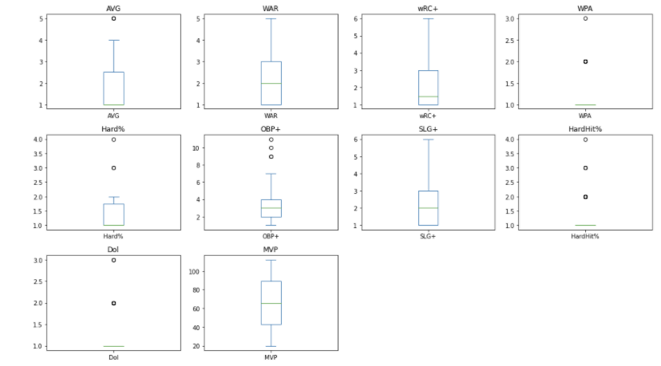
Exploratory Data Analysis – Data Exploration

Slide 6
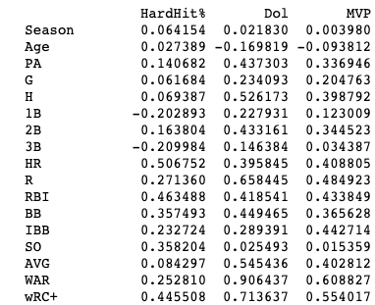
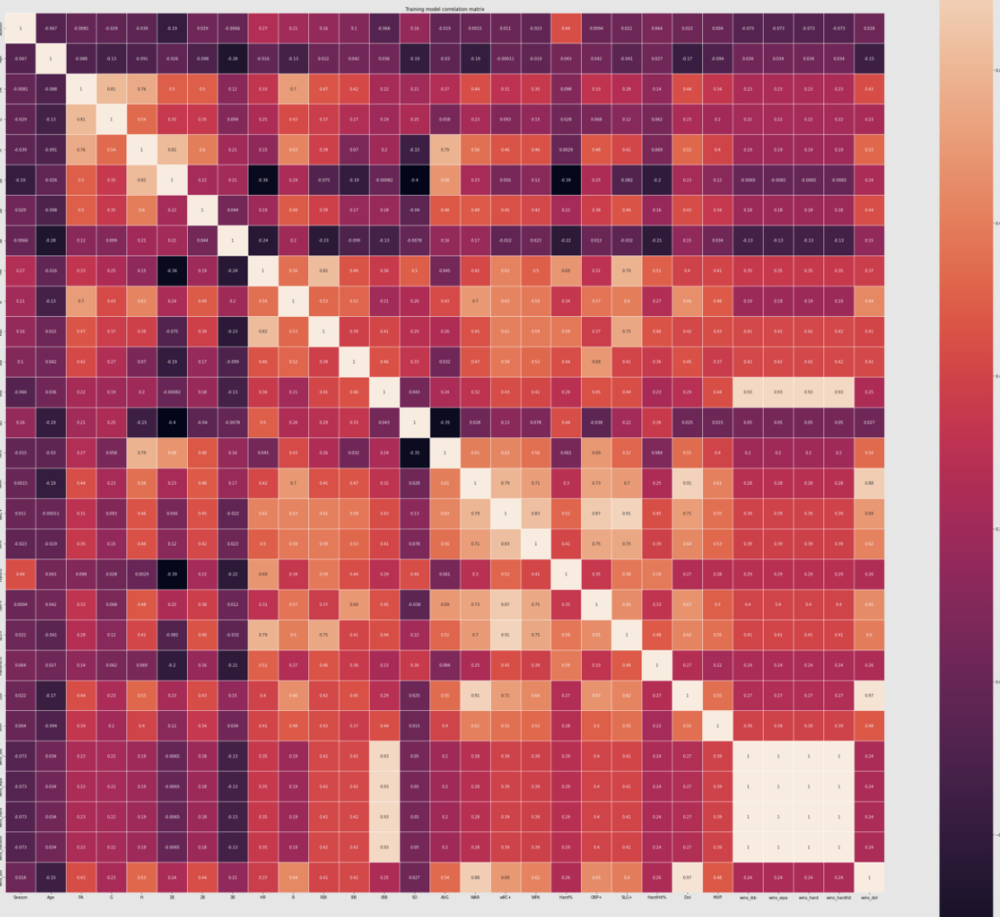
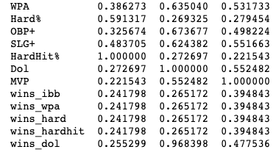
Exploratory Data Analysis – Feature Engineering

Slide 7
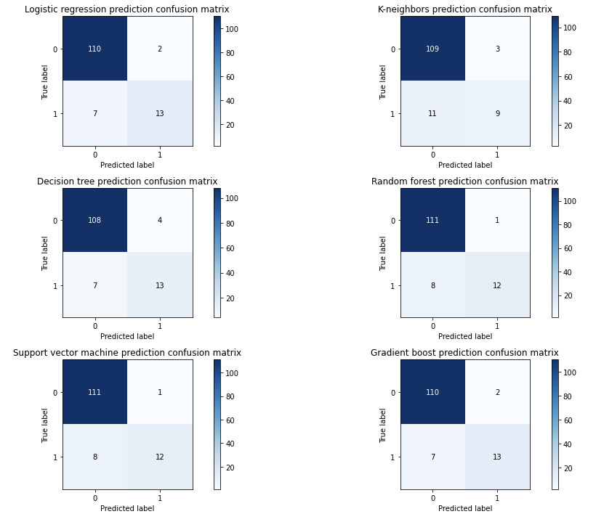
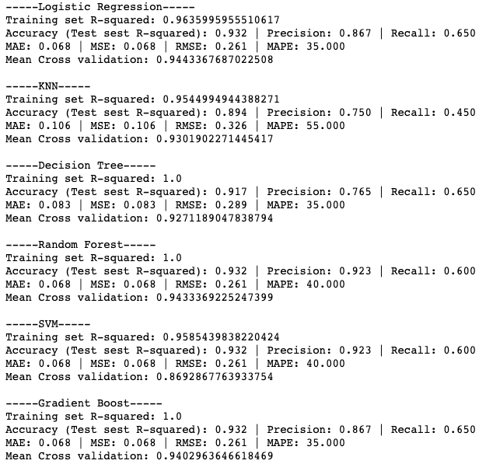
Machine Learning

Slide 8
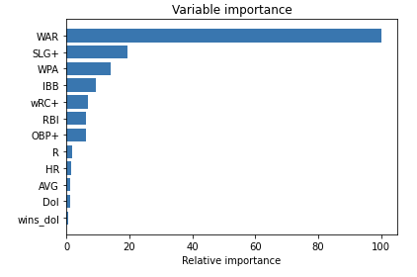
Conclusion
With 12 features that we have selected, all models performed well in predicting who will be the top 10 MVP nominee in each league. Even with the regularization, the accuracy, precision, and recall did not drastically drop. Looking at the feature importance, WAR is by far the most important feature in predicting the MVP nominee. For the next model, I will go back to feature engineering and only use SLG+, WPA, IBB, wRC+, RBI, and OBP+ to see if I will get the same high-performing models.

